Slide 1
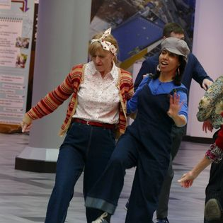
Lindy hop quiz

Slide 2
WHICH dances came before Lindy Hop?
Charleston
Juba
Breakaway
All

Slide 3


Right answer
All
Go to question 2

Slide 4

Wrong answer
Try again – go back.

Slide 5
What was the name of the ballroom where Lindy Hop dancers danced?
Saveloy
Samoyed
Savoy

Slide 6
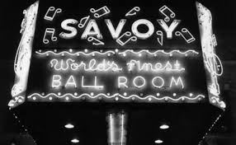
Right answer
Go to question 3

Slide 7

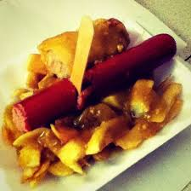
Wrong answer
A saveloy is a sausage with seasoning. It is often red in colour. It is boiled. You can buy these from fish and chip shops.
Try again – go back.

Slide 8
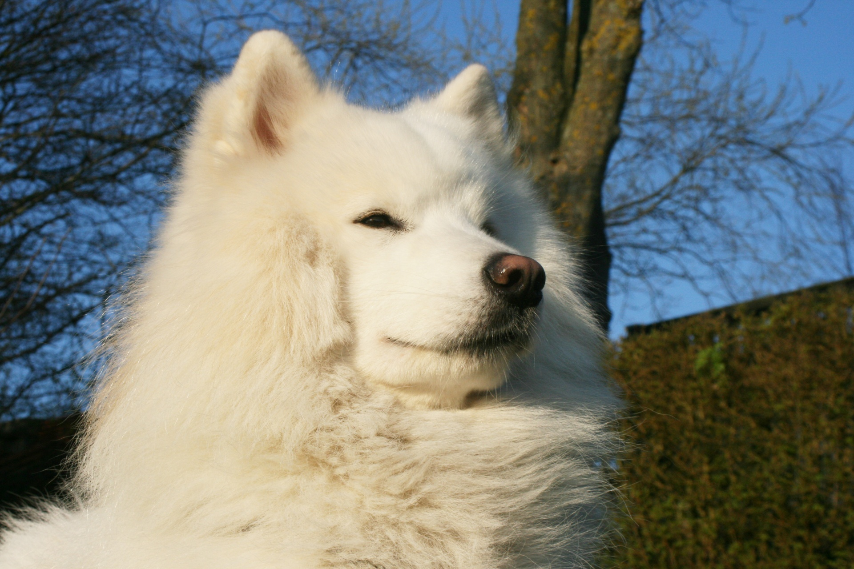
Wrong answer
A Samoyed is a type of dog. Often called the Smiling Dog or the Reindeer Dog. They herded and looked after reindeer.
Try again – go back.

Slide 9

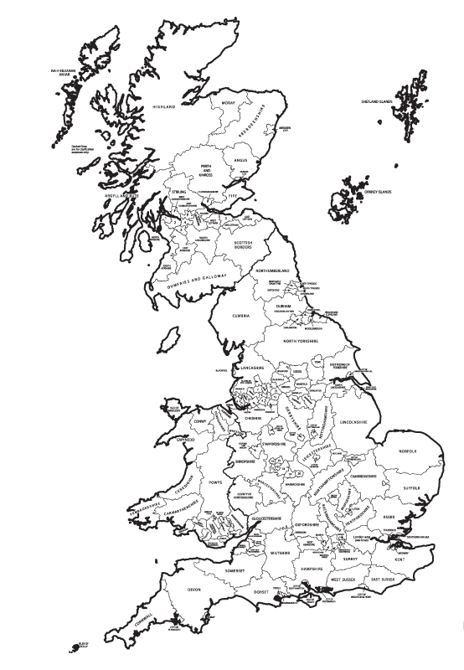
Which country did Lindy Hop come from?
United Kingdom
(UK)
United States of America (USA)

Slide 10
Right answer
Go to question 4

Slide 11
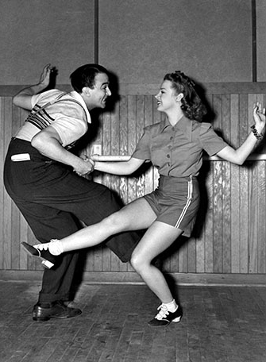
Wrong answer
Lindy Hop came to England when American soldiers came over.
Try again – go back.

Slide 12
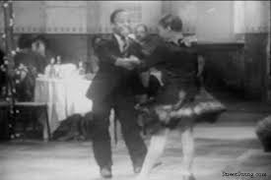
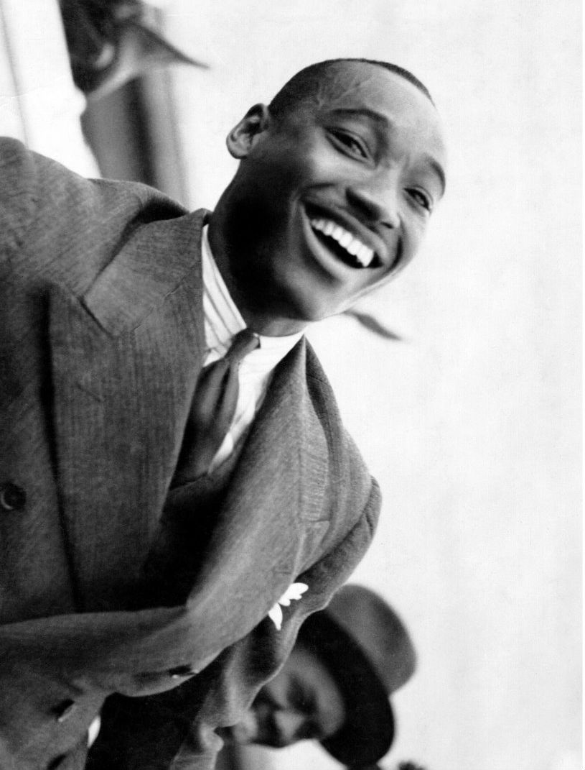
Who named the dance “Lindy Hop”?
Shorty George Snowden
Frankie Manning

Slide 13
Right answer
Go to question 5

Slide 14
Wrong answer
Frankie Manning did not name the dance, but he is one of the greatest Lindy Hop dancers.
Try again – go back.

Slide 15
What was the name of the man who ‘hopped’ across the Atlantic?
Charles Lindbergh
Charles Lunar
Charles Iceberg

Slide 16
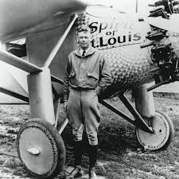
Right answer
Charles Lindbergh was the first person to fly solo nonstop across the Atlantic in 1927.
Born: February 4, 1902 Died: August 26, 1974 (age 72)
Go to question 6

Slide 17
Wrong answer
Try again – go back.

Slide 18
What was the savoy ballroom known as?
The home of hairy feet.
The home of heavy feet.
The home of happy feet.

Slide 19
Right answer
Go to question 7

Slide 20
Wrong answer
Try again – go back.

Slide 21
Who invented the first air-step?
Francis Mannering
Francesca Mainwaring
Frankie Manning

Slide 22

Right answer

Slide 23
Wrong answer
Try again – go back.

